Slide 1

Working with Directories
MODULE 1: GETTING STARTED & NAVIGATING THE SYSTEM

Slide 2
INDEX
Directory Management in Linux
Concept of spaces in Linux
Creating Directories
Removing Directories
rm command
Wildcards in Linux
Various options with rm command
Absolute vs Relative Path in Linux

Slide 3
Directory Management in Linux
Directories in Linux are special types of files that store metadata mappings to other files and directories, organizing the filesystem in a hierarchical structure.
  Directories act as containers for files and subdirectories.
  The root directory (/) is the top-level directory in Linux.
  Special directories like . (current directory) and .. (parent directory) are used for navigation.
  Each directory can contain multiple files and subdirectories.
In Linux, Managing directories is primarily done through the command-line interface.
The core operations involve navigating, listing, creating, moving, and deleting directories using a set of standard utilities.

Slide 4
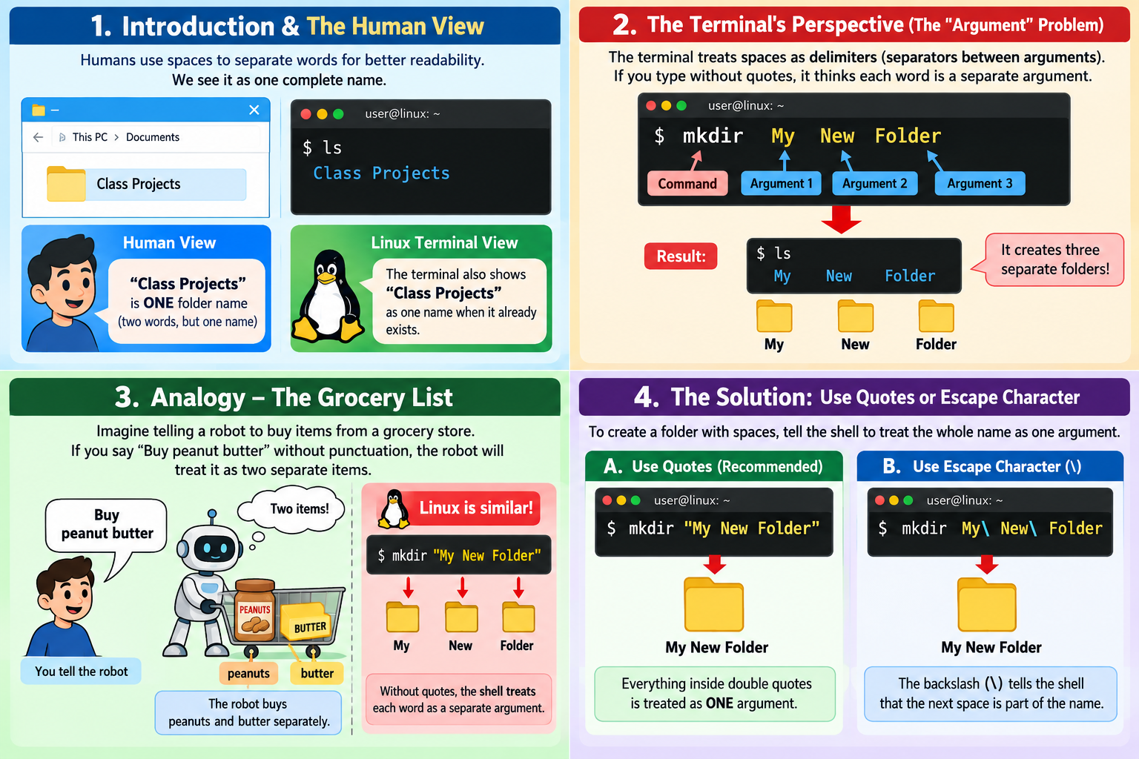
Concept of Spaces in Linux

Slide 5
Creating Directories
The mkdir command is is used to create new directories (which are also referred to as folders in some operating systems). Its syntax is
mkdir [option] directory_name(s)
To create multiple directories – mkdir dir1 dir2
To create dir3 directly make sure dir1, dir2 available – mkdir dir1/dir2/dir3
To create a directories in the specified path – mkdir –p dir1/dir2/dir3
  - p means path of directories
  dir1 will be created. In that dir2 will be created & within that dir3 will be created
  The most common use of –p in the Linux terminal is with mkdir. It creates a directory path automatically.

Slide 6
Removing Directories
The rmdir command provides another way to remove empty directories. Its syntax is:
rmdir [option] directory_name(s)
Note: We cannot use rmdir for files. If the directory is not empty, then we will get an error.
To remove multiple empty directories,
rmdir dir1 dir2

Slide 7
rm command
The rm command is often the most efficient way to remove files and directories. Its syntax is
rm [option] file_name(s)
To delete file1, the following command would be used:
rm file1
To delete both file2 and file3, the following command would be,
rm file2 file3
This can be tedious if it desired to delete a large number of files, such as all files within a directory. A much more efficient (but also more dangerous) way to do this is to use wildcards, which can be used to represent anything.

Slide 8
Wildcards in Linux
In Linux, wildcards (also known as globbing patterns) allow you to target multiple files or directories at once based on character patterns rather than typing every filename individually.
Crucially, the rm command itself does not process wildcards. Instead, your Linux shell (like Bash or Zsh) automatically expands the wildcard pattern into a complete list of matching filenames before passing them to rm
Common Wildcards Used:
The Asterisk (*) – Matches Zero or More Characters
The Question Mark (?) – Matches Exactly One Character
Square Brackets ([]) – Matches a Defined Character Set

Slide 9
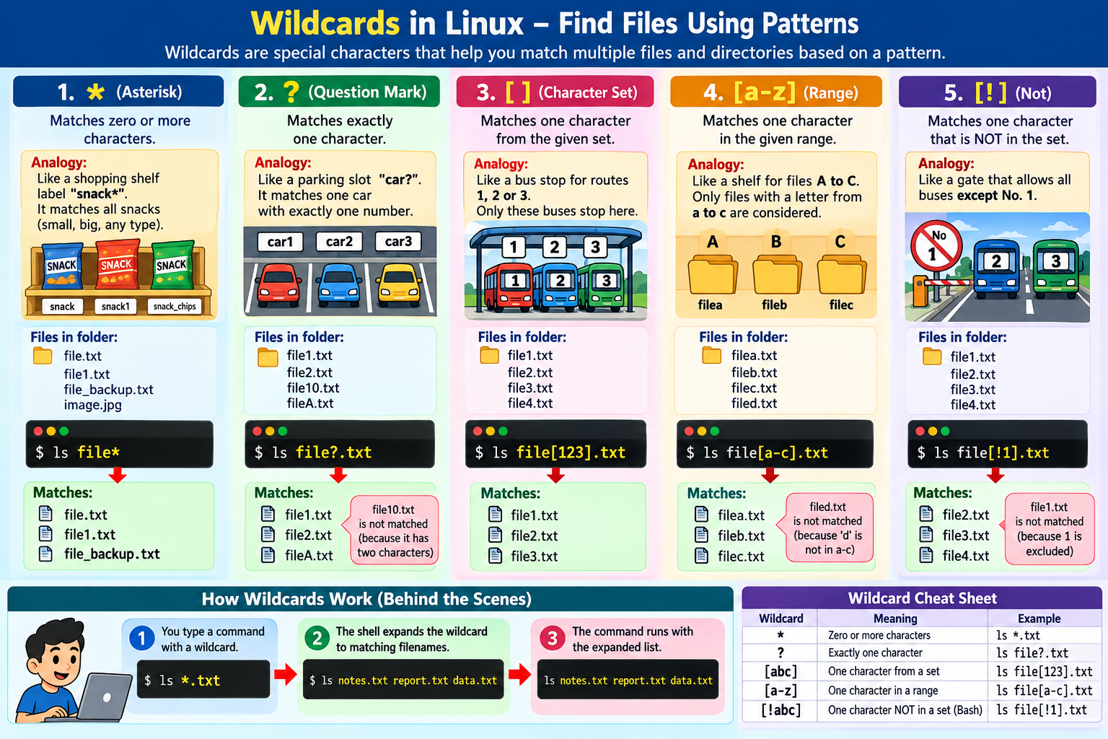

Slide 10
Various options with rm cmd
Option | Long Option | Description | Example
-f | --force | Ignores nonexistent files and never prompts for confirmation, even if a file is write-protected. | rm -f abc.txt
-i | --interactive=always | Prompts for confirmation before deleting every single file. | rm -i abc.txt
-I | --interactive=once | Prompts only once before deleting more than three files, or when deleting recursively. | rm -I *.log
-r (or) -R | --recursive | Removes directories and all of their contents (subfolders and files) recursively. | rm -r test/
-d | --dir | Removes empty directories only (similar to rmdir). | rm -d dev
-v | --verbose | Explains what is being done, printing the name of each file as it is deleted. | rm -v cache.tmp

Slide 11
Absolute vs Relative Path in Linux
The primary difference between an absolute and a relative path in Linux is their starting point: an absolute path always starts from the root directory (/), while a relative path starts from your current working directory.
Feature | Absolute Path | Relative Path
Starting Point | The system root directory (/) | Your current working directory (pwd)
Syntax Start | Always begin with a forward slash / | Never begins with a forward slash /
Location Dependency | Independent of where you currently are | Changes meaning depending where you are
Best Used for | System configurations, cron jobs, and automation scripts | Interactive terminal navigation and portable code projects

Slide 12
